Slide 1

The Spark (R)Evolution in The Netherlands
Spark Summit Europe 2016

Slide 2


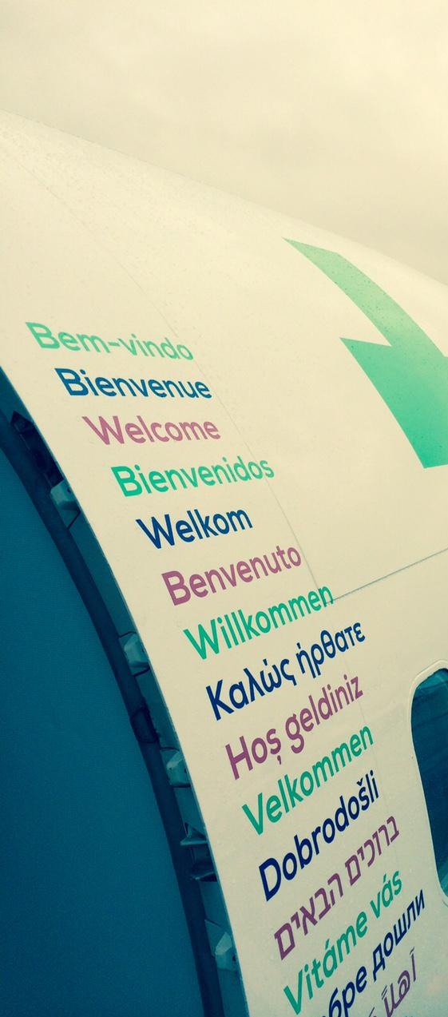

Slide 3
You are here

Slide 4


Slide 5
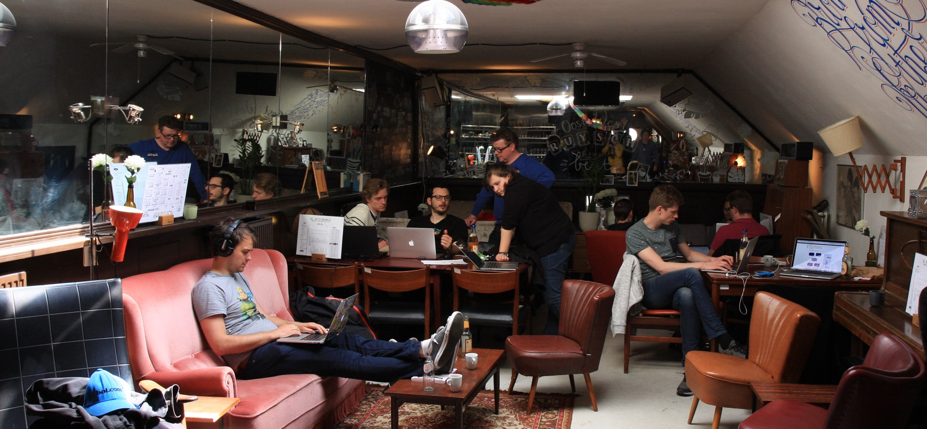

Slide 6
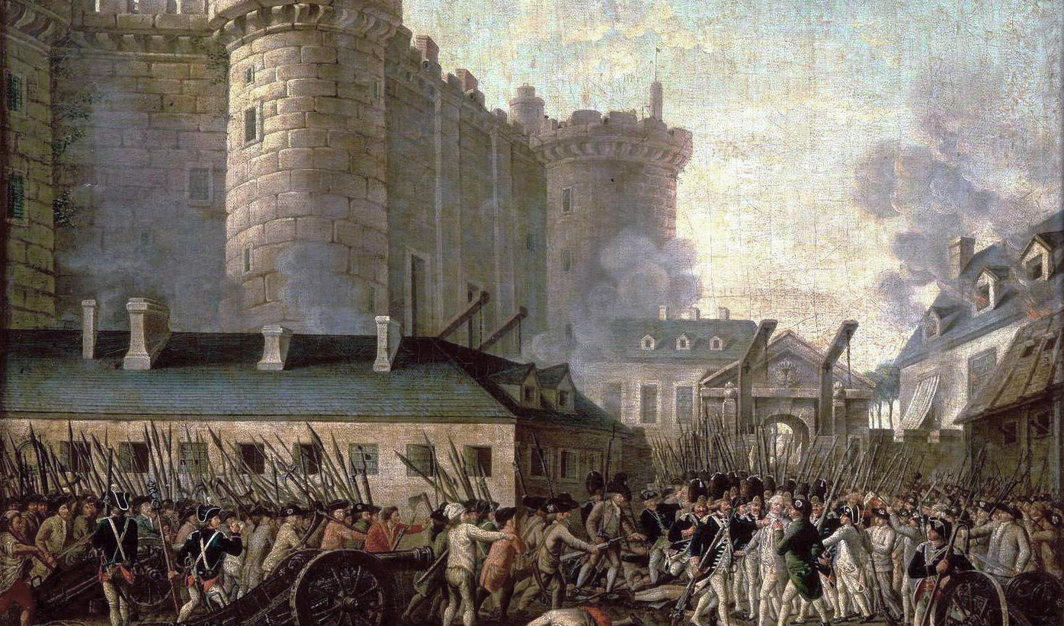

Slide 7
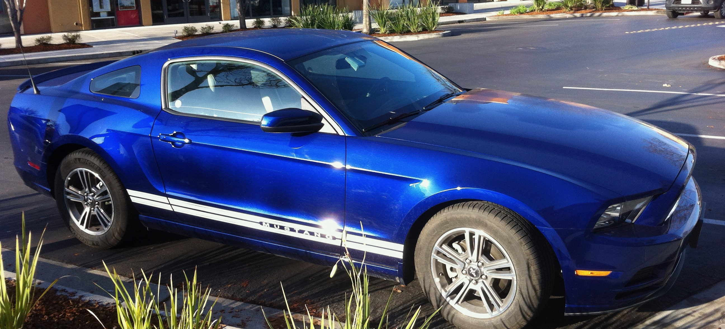

Slide 8
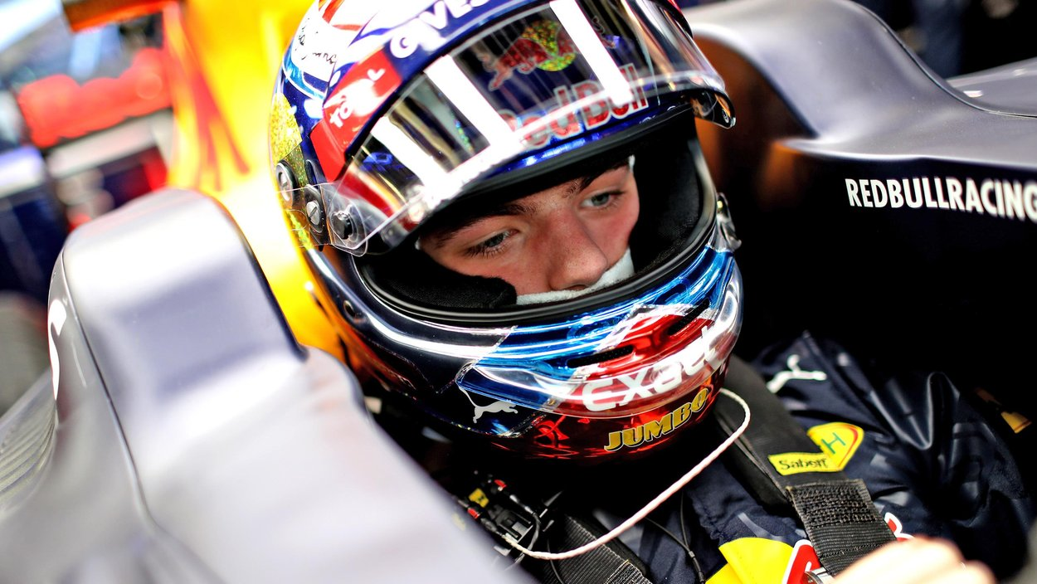

Slide 9


Slide 10






Slide 11
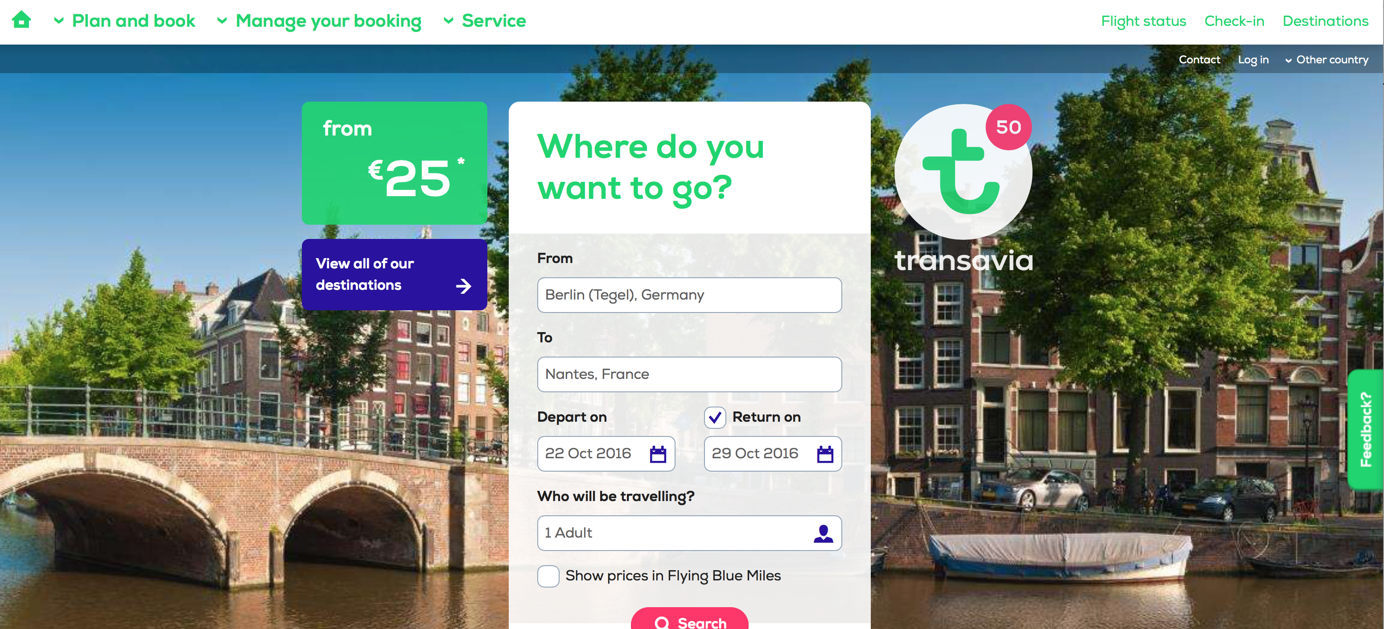


Slide 12


Slide 15
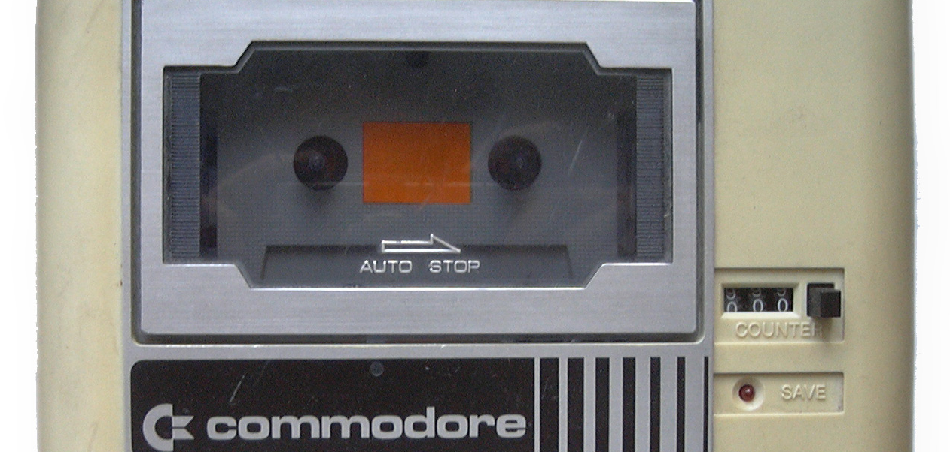

Slide 16


Slide 17


Slide 19
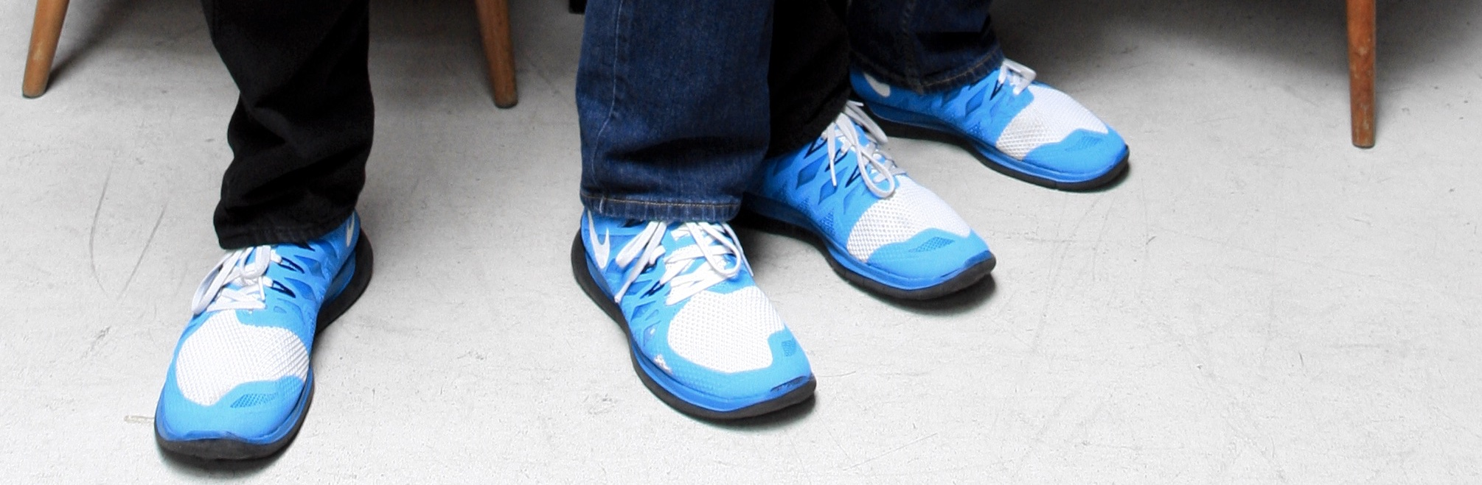
Thank you!
We're hiring!
godatadriven.com

